Slide 1

Timing In The Technology Value Stream
CSD-380 Assignment 1.2
Jess Monnier
17 August 2025

Slide 2

AGENDA
Lead Time Vs. Processing Time
Long Lead Times (months)
Short Lead Times (Minutes)
References

Slide 3
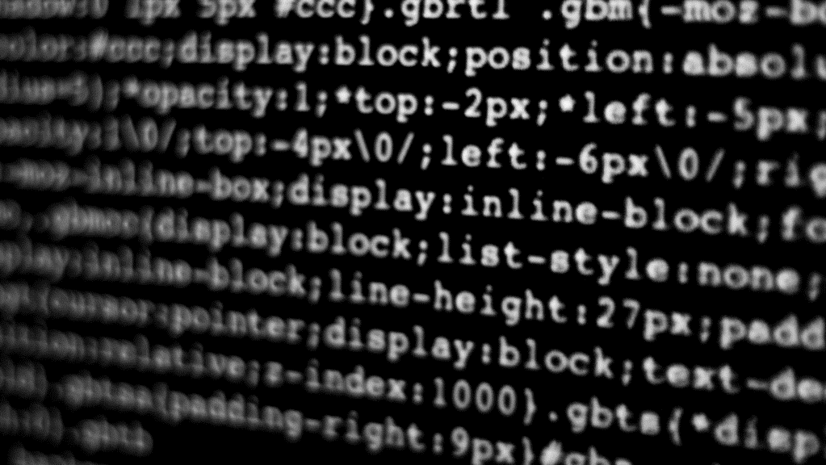
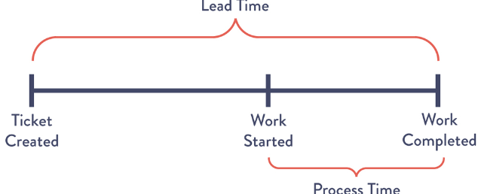
Lead Time Vs. Processing Time
Definitions

Slide 4

Lead and Processing Time Defined
Lead Time:
The time from a request being made to when it is fulfilled
Reflects the customer’s experience
Processing Time:
The time from starting to finishing work on a request
Does not include time in the queue
Another common definition of lead time is the time between committing code to the codebase and that code actually being deployable.

Slide 5
Long Lead Times
Development Lead Times Requiring Months: An Unfortunately Common Reality

Slide 6
Long Lead Times
A value stream with lead times measuring in months likely includes some or all of these contributing factors:
Factor | Impacts
Tight coupling within the system | Merging the changes together results in code that no longer builds correctly and/or cannot pass the established tests
A lack of integration test environments | Teams must wait for access to shared environments, delaying testing and validation
High reliance on manual testing | Testing takes significantly longer and is error-prone
Multiple (and/or complex) approval processes | Changes are delayed in review queues, increasing wait times, often in ways unrelated to the risk of the change

Slide 7
Short Lead Times
Development Lead Times Requiring Minutes: The DevOps Ideal

Slide 8
Short Lead Times
In an ideal DevOps environment…
Feedback is provided to developers quickly and consistently
Code changes are small and frequently check in to a version control repository
Code is highly modular/decoupled and well encapsulated
Testing is automated when possible
Approval processes are simple and streamlined, perhaps with some portions automated
With these concepts implemented, lead time can become something measured in hours or even minutes, and when problems do occur within the code the impact is small rather than system-wide.

Slide 9
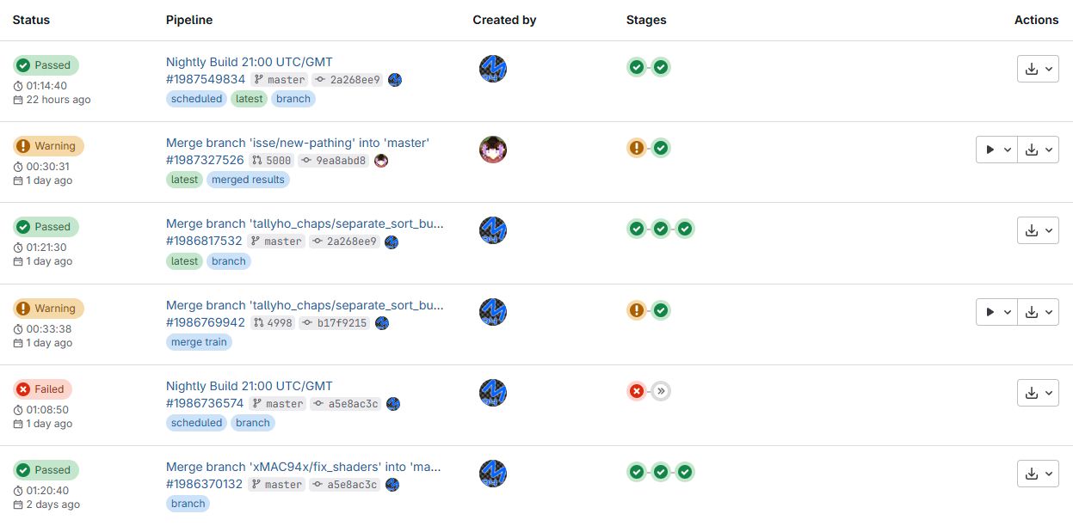
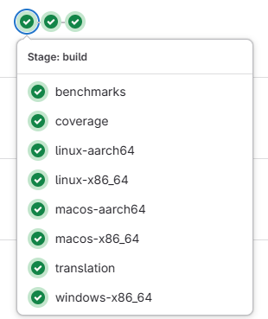
Example with GitLab
This is an example of the Veloren CI/CD pipeline on GitLab. The stages include a number of automated tests that are run whenever code changes are submitted to the codebase, making it easy to track changes and their impacts.

Slide 10

References
Bigelow, S.J. (2023, February 6). What is value stream management? TechTarget. https://www.techtarget.com/searchcio/definition/value-stream-management
Kim, G., Humble, J., Willis, J., & Allspaw, J. (2016). The DevOps Handbook: How to Create World-Class Agility, Reliability, & Security in Technology Organizations (Second Edition). IT Revolution Press.
Takakura, T. (n.d.). What is Value Stream Management (VSM) and Why is it Important? Atlassian. https://www.atlassian.com/agile/value-stream-management

